Slide 1
Gender Differences in Risk Preference: A Case Study in Jeopardy!
Dody Eid

Slide 2

Economic Risk
Utility Models
Exponential Utility: $U\left(x\right)=1 −e^{−αx}$
$α$ is the coefficient of absolute risk aversion
$α$ > 0 implies risk aversion, $α$ = 0 implies risk neutrality, $α$ < 0 implies risk-seeking
An individual’s decision can reveal something about their alpha

Slide 3
Jeopardy! as a Natural Experiment
Full game of Jeopardy! here.
A lock game is a nice environment: wagers by the leader express some level of risk tolerance.
Leader (P3) can wager up to: $7,000 (15,000 – 2*4,000). Victory is assured.
In our case, the $5,000 wager expresses some level of risk tolerance. A wager like $6,000 would be more risk-seeking.
We can pinpoint an exact level of risk aversion under exponential utility.
Lock Game Example
 | Player 1 | Player 2 | Player 3
Pre-FJ Score | $1,200 | $4,000 | $15,000
Wager | $0 | $0 | $5,000
Final Score | $1,200 | $4,000 | $20,000

Slide 4
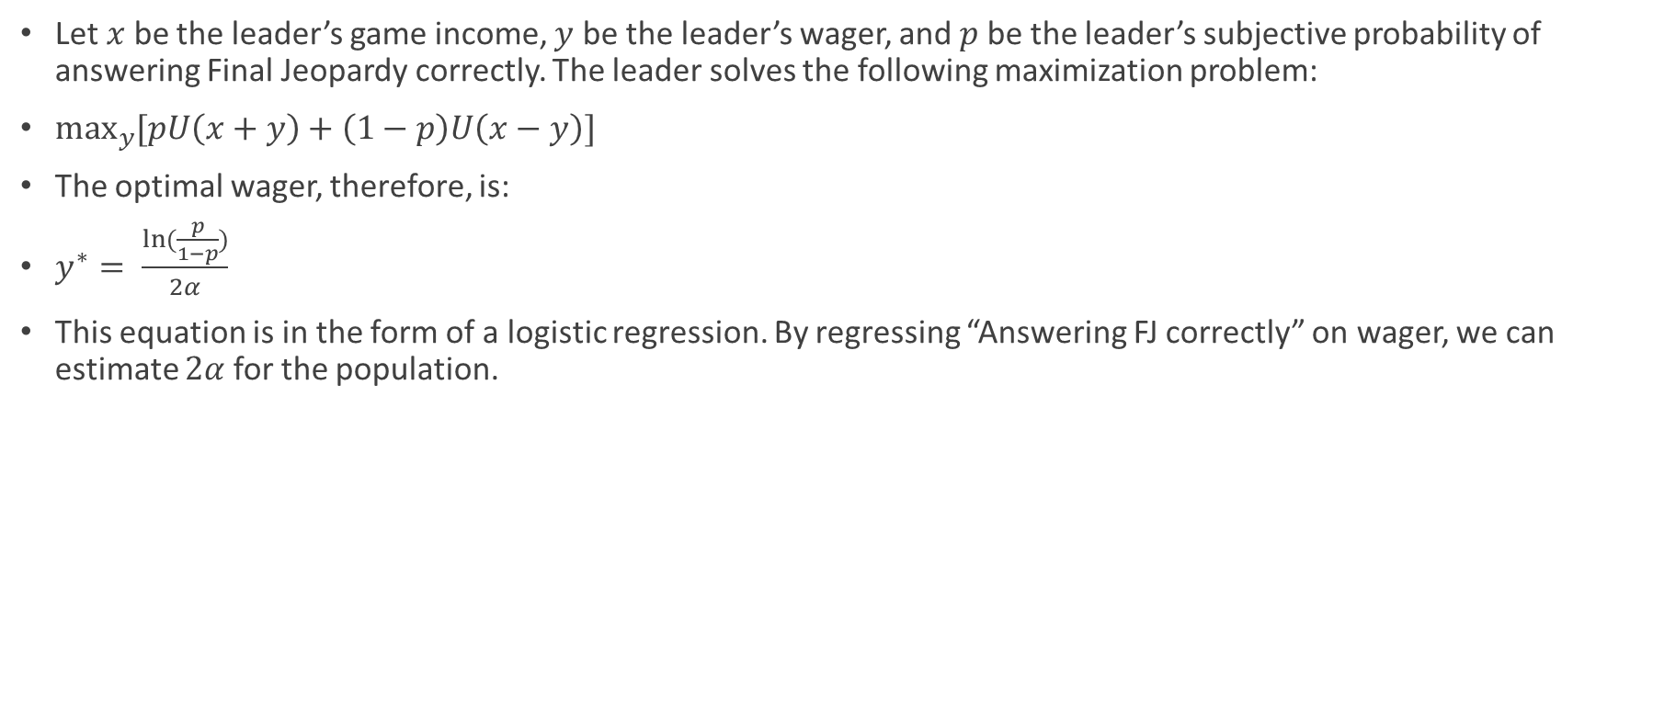
The Lock Game Leader’s Optimal Wager (Metrick 1995)
Let $x$ be the leader’s game income, $y$ be the leader’s wager, and $p$ be the leader’s subjective probability of answering Final Jeopardy correctly. The leader solves the following maximization problem:
$\max_{y}{[pU\left(x+y\right)+\left(1−p\right)U\left(x−y\right)]}$
The optimal wager, therefore, is:
$y^{∗}= \frac{ln⁡(\frac{p}{1−p})}{2α}$
This equation is in the form of a logistic regression. By regressing “Answering FJ correctly” on wager, we can estimate $2α$ for the population.

Slide 5
Adjusting the Metrick Model
The Metrick model has three shortcomings that I discuss thoroughly in the thesis.
First, the model does not actually allow for meaningful conclusions regarding a specific level of risk tolerance for a group of people on Jeopardy!. It does, however, allow for intergroup risk tolerance comparison under some assumptions.
Second, the logistic regression forces a zero intercept, which is heavily data-dependent.
Third, the model does not account for overconfidence.

Slide 6
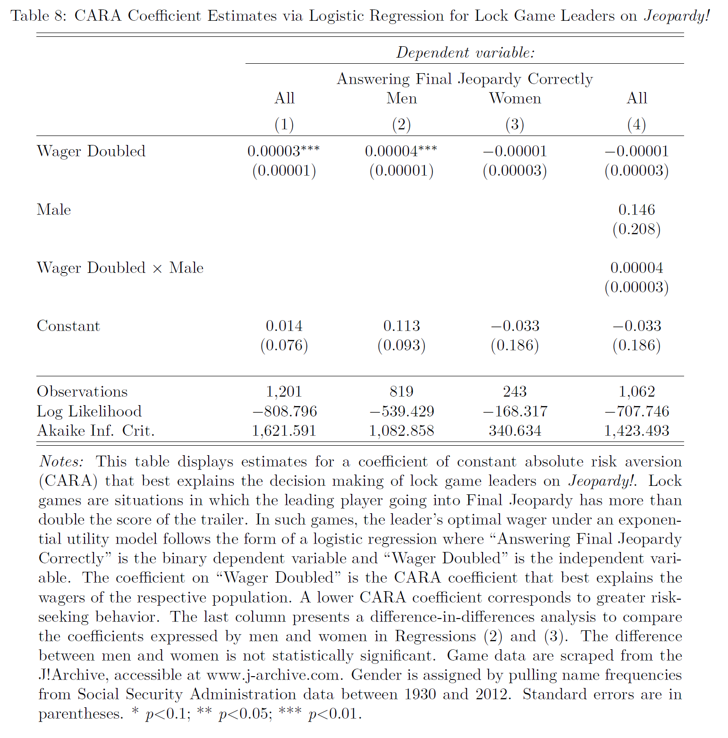
Metrick Replication by Gender

Slide 7
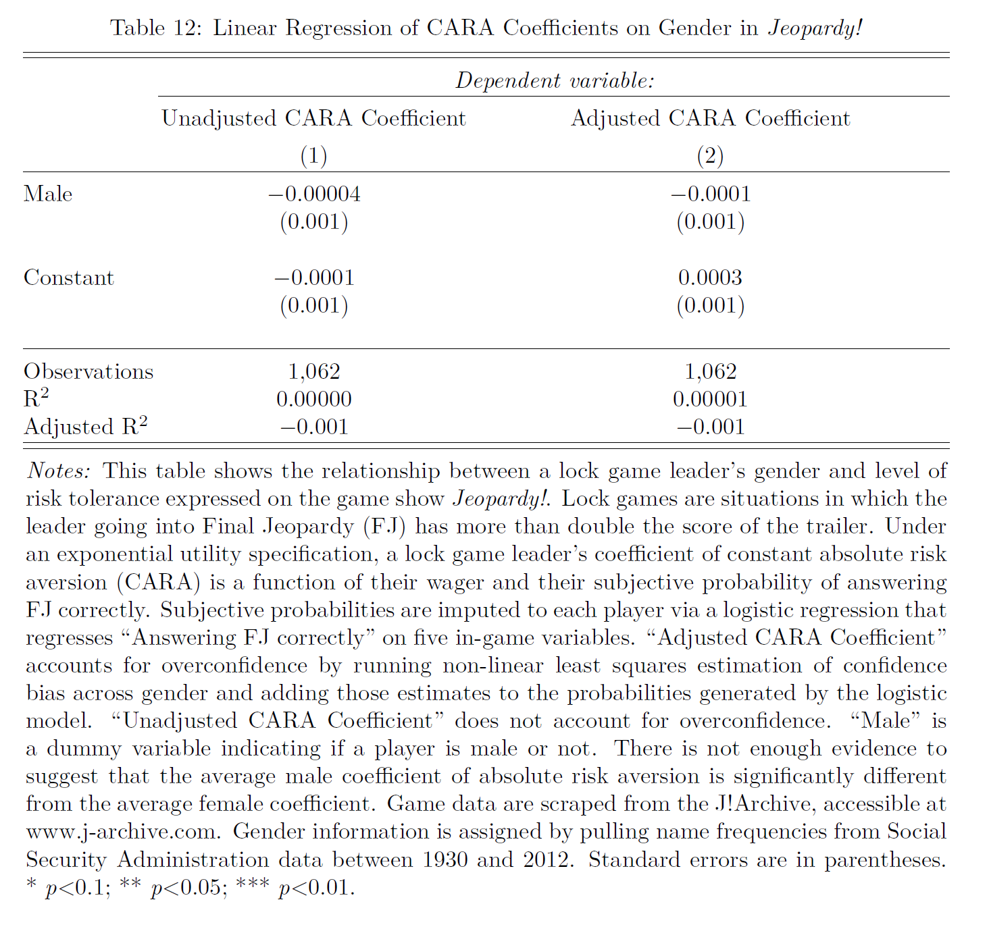
Main Result

Slide 8
Questions?
Dody Eid
deid@college.harvard.edu
Happy to help with R or answer any other questions ☺

